Slide 1
ESC101: Introduction to Computing
Conditional Expressions

Slide 2

Conditional Expressions
An expression that evaluates to either true or false.
Often known as Boolean expression.
C does not have a separate Boolean data type
Value 0 is treated as false.
Non-zero values are treated as true.

Slide 3
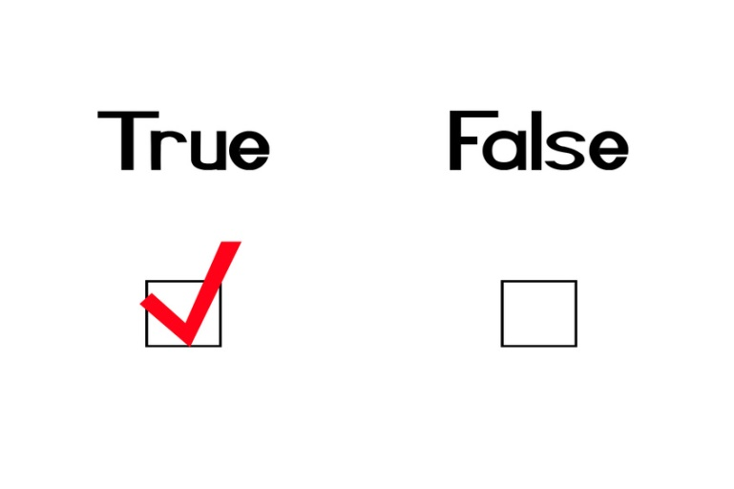
Conditional Expressions
If an expression evaluates to true, we get a value 1
Think of 1 as default true value
If an expression evaluates to false, we get a value 0

Slide 4
Relational Operators
Compare two quantities
Work on int, char, float, double…
Operator | Function
> | Strictly greater than
>= | Greater than or equal to
< | Strictly less than
<= | Less than or equal to
== | Equal to
!= | Not equal to

Slide 5
Examples
Rel. Expr. | Result | Remark
3>2 | 1
3>3 | 0
‘z’ > ‘a’ | 1 | ASCII values used for char
2 == 3 | 0
‘A’ <= 65 | 1 | 'A' has ASCII value 65
‘A’ == ‘a’ | 0 | Different ASCII values
(‘a’ – 32) == ‘A’ | 1
5 != 10 | 1
1.0 == 1 | AVOID | May give unexpected result due to approximation
Avoid mixing int and float values while comparing. Comparison with floats is not exact!

Slide 6
Logical Operators
Logical Op | Function | Allowed Types
&& | Logical AND | char, int, float, double
|| | Logical OR | char, int, float, double
! | Logical NOT | char, int, float, double
Remember
value 0 represents false.
any other value represents true.

Slide 7
Truth Tables
E1 | E2 | E1 && E2 | E1 || E2
0 | 0 | 0 | 0
0 | Non-0 | 0 | 1
Non-0 | 0 | 0 | 1
Non-0 | Non-0 | 1 | 1
E | !E
0 | 1
Non-0 | 0

Slide 8
Examples
Expr | Result | Remark
2 && 3 | 1
2 || 0 | 1
‘A’ && ‘0’ | 1 | ASCII value of ‘0’≠0
‘A’ && 0 | 0
‘A’ && ‘b’ | 1
! 0.0 | 1 | 0.0 == 0 is guaranteed
! 10.05 | 0 | Any real ≠ 0.0
(2<5) && (6>5) | 1 | Compound expr

Slide 9
Examples
You can create very complex expressions, involving arithmetic, logical and relational operators, constants, variables, function calls. e.g:
(x + 7 > 93) && !(y + 3 % z)
|| (abs(sqrt(w) – g) < epsilon)

Slide 10
Example
Problem: Input 3 positive integers. Print the count of inputs that are even and odd.
Do not use if-then-else
INPUT
10
5
3
OUTPUT
Even=1
Odd=2
int a; int b; int c;
int cEven; // count of even inputs
scanf(“%d%d%d”, &a,&b,&c); // input a,b,c
// (x%2 == 0) evaluates to 1 if x is Even,
// 0 if x is Odd
cEven = (a%2 == 0) + (b%2 == 0) + (c%2 == 0);
printf(“Even=%d\nOdd=%d”, cEven, 3-cEven);

Slide 11

Precedence and Associativity (Refined)
Binary Operations!
Operate on 2 Arguments
Result is either 0 or 1
! + -
RL
* / %
LR
+ -
LR
< <= > >=
LR
== !=
LR
&&
LR
||
LR
=
RL

Slide 12

Class Quiz 2
What is the value of expression:
Compile time error
Run time crash
False (0)
True (1)
0 <= 10 <= 4
The correct answer is

Slide 13
Evaluation
Probably not what you intended. The intended expression is:
0 <= 10 <= 4
(0 <= 10) <= 4
1 <= 4
1 /* True */
0 <= 10 && 10 <= 4
(0 <= 10) && (10 <= 4)
(1) && (10 <= 4)
1 && (0)
0 /*False*/

Slide 14
Conditional Statements
In daily routine
If it is very cold, I will skip class.
If there is a quiz tomorrow, I will first study and then sleep. Otherwise I will sleep now.
If I have 500 Rs, I will order pizza. If I have 20 Rs, I will eat Maggi. If I have 5 Rs, I will eat biscuits. If I do not have any money, I will eat in hostel mess ☺

Slide 15
Conditional statements in C
3 types of conditional statements in C
if (cond) action
else some-other-action
if (cond) action
switch-case
Each action is a sequence of one or more statements!

Slide 16
Statements and Blocks
An expression such as x=0 or printf(…) becomes a statement when it is followed by a semi-colon, as in
x = 0;
printf( … );
5+2;
Braces { and } are used to group variable declarations and statements together into a compound statement or a block
Syntactically equivalent to a single statement.
Can use it anywhere a single statement can be used

Slide 17
Statements and Blocks
{
int x; float y; /* 2 statements */
x = 10;
printf(“x = %d\n”, x);
}
A single block

Slide 18
if-else statement
Read two integers and print the min.
# include <stdio.h>
int main() {
int x, y;
scanf(“%d%d”, &x,&y);
if (x < y) {
printf(“%d”, x);
} else {
printf(“%d”, y);
}
return 0;
}
Check if x is less than y.
If so, print x
Otherwise, print y.

Slide 19
Tracing Execution of if-else
Run the program
# include <stdio.h>
int main() {
int x; int y;
scanf(“%d%d”, &x,&y);
if (x < y) {
printf(“%d\n”,x);
}
else { printf(“%d\n”,y);}
return 0;
}
Input
6 10
x
y
6
10
6 < 10 so the if-branch is taken
Output
6

Slide 20
if-else statement
General form of the if-else statement
Execution of if-else statement
First the expression is evaluated.
If it evaluates to a non-zero value, then S1 is executed and then control (program counter) moves to S3.
If expression evaluates to 0, then S2 is executed and then control moves to S3.
S1/S2 can be block of statements!
if (expression)
statement S1
else
statement S2
statement S3
true
false
S1
S2
S3

Slide 21
if statement (no else!)
General form of the if statement
Execution of if statement
First the expression is evaluated.
If it evaluates to a non-zero value, then S1 is executed and then control (program counter) moves to the statement S2.
If expression evaluates to 0, then S2 is executed.
if (expression)
statement S1
statement S2
true
false
S1
S2

Slide 22
Example
Problem: Input a, b, c are real positive numbers such that c is the largest of these numbers. Print ACUTE if the triangle formed by a, b, c is an acute angled triangle and print NOT ACUTE otherwise.
int main() {
float a; float b; float c;
scanf(“%f%f%f”, &a,&b,&c); /* input a,b,c */
if ( (a*a + b*b) > (c*c) ) { /* expression*/
printf(“ACUTE”);
}
else {
printf(“NOT ACUTE”);
}
return 0;
}

Slide 23
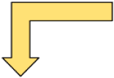



Finding min of 3 numbers
Input a,b,c
TRUE
a<=b
FALSE
TRUE
a<=c
FALSE
TRUE
b<=c
FALSE
Print
a
Print c
Print b
Print
c

Slide 24




Input a,b,c
int a,b,c;
scanf(“%d%d%d”,&a,&b,&c);
if (a <= b) {
if (a <= c) {
printf(“min = %d”,a);
}
else {
printf(“min = %d”, c);
}
}
else {
if (b <= c) {
printf(“min = %d”, b);
}
else {
printf(“min =%d”, c);
}
}
a<=b
TRUE
FALSE
a<=c
b<=c
TRUE
FALSE
TRUE
FALSE
Print
a
Print c
Print b
Print
c
Each branch translates to an if-else statement
Hierarchical branches result in nested if-s

Slide 25
More Conditionals
Sorting a sequence of numbers (i.e., arranging the numbers in ascending or descending order) is a basic primitive.
Problem: read three numbers into a, b and c and print them in ascending order.
Start with the flowchart for finding minimum of three numbers and add one more level of conditional check.
Then translate the flowchart into C program.

Slide 26
Finding min of 3 numbers
Input a,b,c
Replace print by more comparisons and then print.
TRUE
a<=b
FALSE
TRUE
a<=c
FALSE
TRUE
b<=c
FALSE
Print
a
Print c
Print b
Print
c

Slide 27




Ascending order of 3 numbers
Input a,b,c
TRUE
a<=b
FALSE
TRUE
a<=c
FALSE
TRUE
b<=c
FALSE
Print
a
Print c
Print b
Print
c
TRUE
b<=c
FALSE
print
TRUE
a<=c
FALSE
print
c a b
c b a
print
print
print
print
a b c
a c b
b a c
b c a

Slide 28
if (a <= b) {
if (a <= c) { /* a <= b and a <= c */
if (b <= c) { /* a <= b, a <= c, b <= c */
printf(“%d %d %d \n”, a, b, c);
} else { /* a <= b, a <= c, c < b */
printf(“%d %d %d \n”, a, c, b);
}
} else { /* a <= b, c < a*/
printf(“%d %d %d \n”, c, a, b) ;
}
} else { /* b < a */
if (b <= c) { /* b < a and b <= c */
if (a <= c) { /* b < a, b <= c, a <= c */
printf(“%d %d %d\n”, b, a, c);
} else { /* b < a, b <= c, c < a */
printf(“%d %d %d\n”, b, c, a); }
}
} else { /* b < a, c < b */
printf(“%d %d %d\n”, c, b, a); }
}
}
Notes:
28

Slide 29
Nested if, if-else
Earlier examples showed us nested if-else statements
Because if and if-else are also statements, they can be used anywhere a statement or block can be used.
if (a <= b) {
if (a <= c) { … } else {…}
} else {
if (b <= c) { … } else { … }
}

Slide 30
Else if
A special kind of nesting is the chain of if-else-if-else-… statements
if (cond1) {
stmt1
} else {
if (cond2) {
stmt2
} else {
if (cond3) {
….
}
}
}
if (cond1)
stmt-block1
else if (cond2)
stmt-block2
else if (cond3)
stmt-block3
else if (cond4)
stmt-block4
else if …
else
last-block-of-stmt
if (cond1) {
stmt1
} else {
if (cond2) {
stmt2
} else {
if (cond3) {
….
}
}
}
} else
if (cond2) {
stmt2
} else {
if (cond3) {
….
}
}
} else if (cond2) {
stmt2
} else {
if (cond3) {
….
}
}
} else if (cond2) {
stmt2
} else if (cond3) {
…
}
if (cond2) {
stmt2
} else {
if (cond3) {
….
}
}
General form of if-else-if-else…

Slide 31
Else if
A special kind of nesting is the chain of if-else-if-else-… statements
if (cond1) {
stmt1
} else {
if (cond2) {
stmt2
} else {
if (cond3) {
….
}
}
}
if (cond1)
stmt-block1
else if (cond2)
stmt-block2
else if (cond3)
stmt-block3
else if (cond4)
stmt-block4
else if …
else
last-block-of-stmt
General form of if-else-if-else…

Slide 32
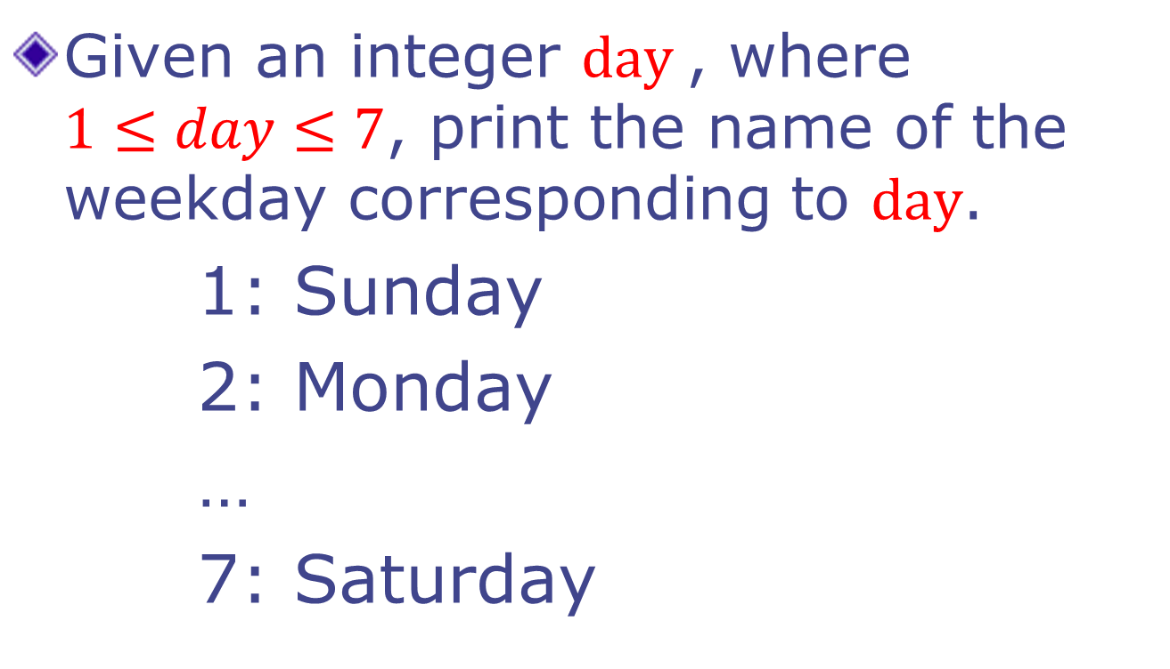
Example
Given an integer $day$, where $1≤day≤7$, print the name of the weekday corresponding to $day$.
1: Sunday
2: Monday
…
7: Saturday

Slide 33
Printing the day
int day;
scanf (“%d”, &day);
if (day == 1) { printf(“Sunday”); }
else if (day == 2) { printf (“Monday”); }
else if (day == 3) { printf (“Tuesday”); }
else if (day == 4) { printf (“Wednesday”); }
else if (day == 5) { printf (“Thursday”); }
else if (day == 6) { printf (“Friday”); }
else if (day == 7) { printf (“Saturday”); }
else { printf (“ Illegal day %d”, day); }

Slide 34
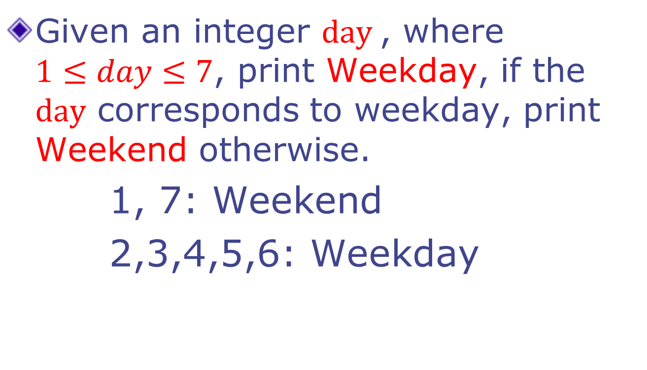
Example 2
Given an integer $day$, where $1≤day≤7$, print Weekday, if the $day$ corresponds to weekday, print Weekend otherwise.
1, 7: Weekend
2,3,4,5,6: Weekday

Slide 35
Weekday - version 1
int day;
scanf (“%d”, &day);
if (day == 1) { printf(“Weekend”); }
else if (day == 2) { printf (“Weekday”); }
else if (day == 3) { printf (“Weekday”); }
else if (day == 4) { printf (“Weekday”); }
else if (day == 5) { printf (“Weekday”); }
else if (day == 6) { printf (“Weekday”); }
else if (day == 7) { printf (“Weekend”); }
else { printf (“ Illegal day %d”, day); }

Slide 36
Weekday - version 2
int day;
scanf (“%d”, &day);
if ((day == 1) || (day == 7)) {
printf(“Weekend”);
} else if ( (day == 2) || (day == 3)
|| (day == 4) || (day == 5)
|| (day == 6)) {
printf (“Weekday”);
} else {
printf (“ Illegal day %d”, day);
}

Slide 37
Weekday - version 3
int day;
scanf (“%d”, &day);
if ((day == 1) || (day == 7)) {
printf(“Weekend”);
} else if ( (day >= 2) && (day <= 6) ) {
printf (“Weekday”);
} else {
printf (“ Illegal day %d”, day);
}

Slide 38
Summary of if, if-else
if-else, nested if's, else if.
Braces {…} can be omitted if a block has only one statement.
Multiple ways to solve a problem
issues of better readability
and efficiency.

Slide 39
Switch-case statement
Multi-way decision
Checks whether an expression matches one out of a number of constant integer (or char) values
Execution branches based on the match found
Oh man! Missed Esc101 major quiz!
Today is Friday

Slide 40
Printing the day, version 2
switch (day) {
case 1: printf(“Sunday”); break;
case 2: printf (“Monday”); break;
case 3: printf (“Tuesday”); break;
case 4: printf (“Wednesday”); break;
case 5: printf (“Thursday”); break;
case 6: printf (“Friday”); break;
case 7: printf (“Saturday”); break;
default: printf (“ Illegal day %d”, day);
}

Slide 41
Weekday, version 4
switch (day) {
case 1:
case 7: printf (“Weekend”); break;
case 2:
case 3:
case 4:
case 5:
case 6: printf (“Weekday”); break;
default: printf (“ Illegal day %d”, day);
}

Slide 42
General Form of switch-case
switch (selector-expr) {
case label1: s1; break;
case label2: s2; break;
...
case labelN: sN; break;
default : sD;
}
default is optional.
The location of default does not matter.
The statements following a case label are executed one after other until a break is encountered (Fall Through)

Slide 43
Fall Through…
int n = 100;
int digit = n%10; // last digit
switch (digit) {
default : printf(“Not divisible by 5\n”);
break;
case 0: printf(“Even\n”);
case 5: printf(“Divisible by 5\n”);
break;
}
What is printed by the program fragment?
Answer:
Even
Divisible by 5;

Slide 44


Class Quiz 3
What is the value of expression:
Compile time error
Run time crash
I don’t know / I don’t care
0
1
(5<2) && (3/0)
The correct answer is

Slide 45
Short-circuit Evaluation
Do not evaluate the second operand of binary logical operator if result can be deduced from first operand
Arguments of && and || are evaluated from left to right (in sequence)
Also applies to nested logical operators
!( (2>5) && (3/0) ) || (4/0)
Evaluates to 1
1
0
0
1

Slide 46
3 Factors for Expr Evaluation
Precedence
Applied to two different class of operators
+ and *, - and *, && and ||, + and &&, …
Associativity
Applied to operators of same class
* and *, + and -, * and /, …
Order of evaluation
Precedence and associativity identify the operands for each operator
Not which operand/expr is evaluated first
Beware: In C, order of evaluation of operands is defined only for && and ||

Slide 47
Unmatched if and else
X
if ((a != 0) && (b != 0))
if (a * b >= 0)
printf (“positive”);
else
printf(“zero”);
OUTPUT for a = 5, b = 0
NO OUTPUT!!
OUTPUT for a = 5, b = -5
zero
if ((a != 0) && (b != 0))
if (a * b >= 0)
printf (“positive”);
else
printf(“negative”);
OUTPUT for a = 5, b = 0
NO OUTPUT!!
OUTPUT for a = 5, b = -5
negative

Slide 48
Unmatched if and else
An else always matches closest unmatched if
Unless forced otherwise using { … }
if (cond1)
if (cond2)
…
else
…
if (cond1) {
if (cond2)
…
else
…
}

Slide 49
Unmatched if and else
An else always matches closest unmatched if
Unless forced otherwise using { … }
if (cond1)
if (cond2)
…
else
…
if (cond1) {
if (cond2)
…
}
else
…
IS NOT SAME AS

